Slide 1
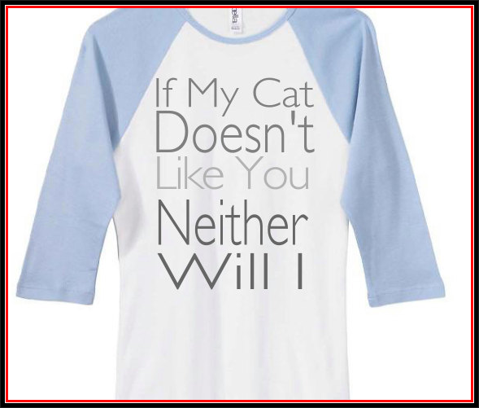
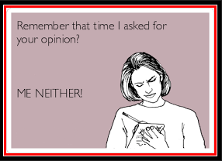
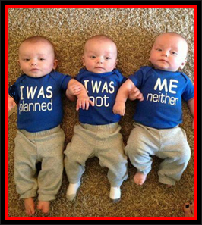
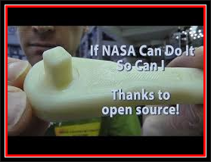
Short Responses

Slide 2
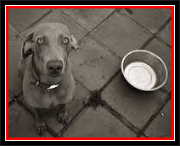
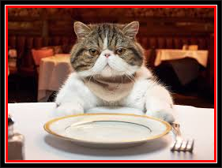
Responses to positive statements using the verb BE
I’m hungry!
So…
So am I.
I…
I am too.
Me…
Me too.
Same here!

Slide 3
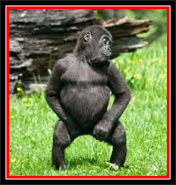
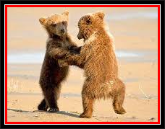
Responses to positive statements using other verbs
I like dancing
So…
So do we.
We…
We do too.
Us…
Us too.
Same here!

Slide 4
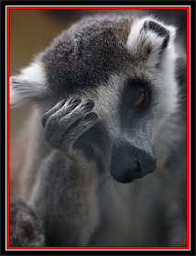
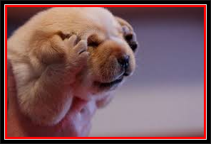
Responses to positive statements using the verb HAVE
I have a terrible headache!
So…
So do I. / So have I.
I…
I do too. / I have too.
Me too.
Same here!

Slide 5
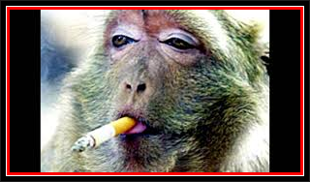
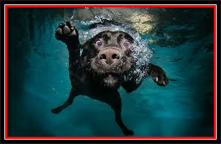
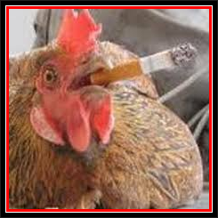
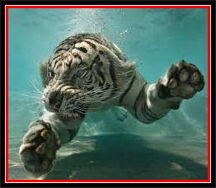
Responses to positive statements using AUXILIARY verbs (can, could, should, will, etc.)
I should stop smoking. I can swim.
↓ ↓
So… So…
So should I. So can I.
I… I…
I should too. I can too.
Me too.
Same here!

Slide 6
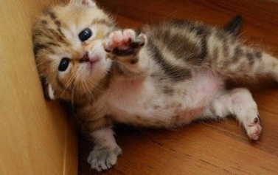
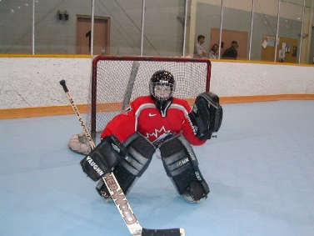
Responses to positive statements using possessives
My kitten is really cute!
→ So am I. ???
→ So is mine.
So... Mine… Mine… Same…
So is mine. Mine is too. Mine too. Same with mine.
So is my kitten. My kitten is too. My kitten too. Same with my kitten.
Her brother plays hockey.
So… Bill’s… Bill’s… Same…
So does Bill’s. Bills’ does too. Bill’s too. Same with Bill’s.
So does Bill’s brother. Bill’s brother does too. Bill’s brother too. Same with Bill’s brother.

Slide 7
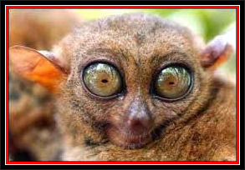
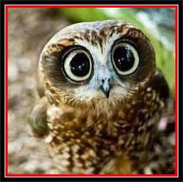
Responses to negative statements using the verb BE
I’m not tired.
Neither…
Neither am I.
I’m…
I’m not either.
Me…
Me neither.
Same here!

Slide 8
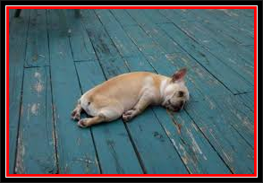
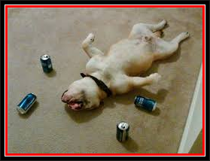
Responses to negative statements using other verbs
I don’t want any more beer.
Neither…
Neither do I.
I…
I don’t either.
Me neither.
Same here!

Slide 9
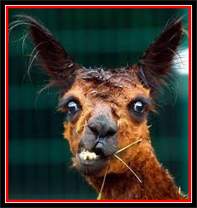
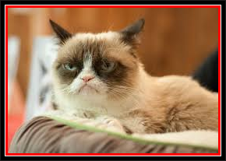
Responses to negative statements using the verb HAVE
I don’t have enough time to do my homework.
Neither…
Neither do I. / Neither have I.
I…
I don’t either. / I haven’t either.
Me neither.
Same here.

Slide 10
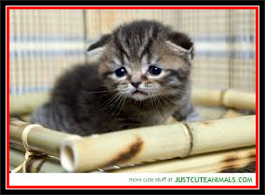
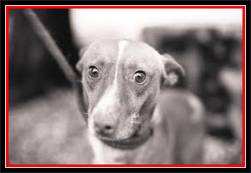
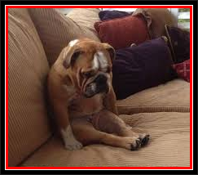
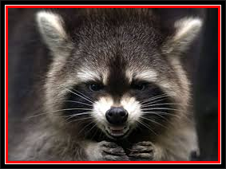
Responses to negative statements using AUXILIARY verbs (can, could, should, will, etc.)
I wouldn’t do that. I won’t be at the party.
↓ ↓
I… I…
I wouldn’t either. I won’t either.
Neither… Neither...
Neither would I. Neither will I.
Me neither.
Same here.

Slide 11
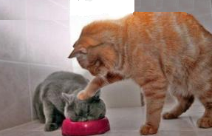
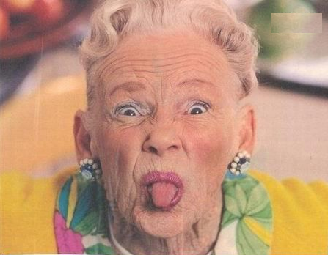
Responses to negative statements using possessives
My cat isn’t very friendly with other cats.
Neither… Mine… Mine… Same…
Neither is mine. Mine isn’t either. Mine neither. Same with mine.
My grandma doesn’t like cheese.
Neither… Mine… Mine… Same…
Neither does mine. Mine doesn’t either. Mine neither. Same with mine.

Slide 12
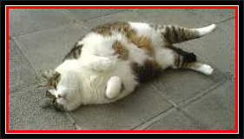
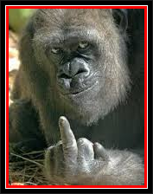
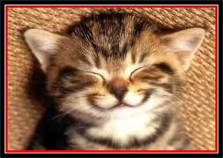
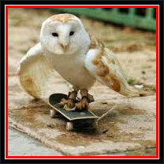
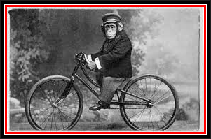
Notes – Disagreement with positive statements
I’m hungry. → I’m not.
I like dancing. → I don’t.
I have a headache. → I don’t. / I haven’t.
I can ride a bicycle. → I can’t.

Slide 13
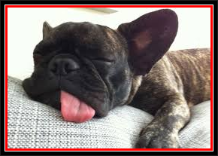
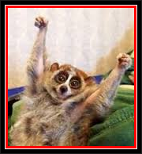
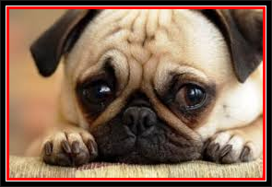
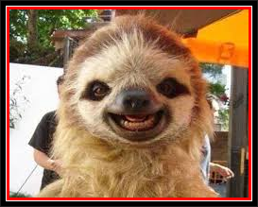
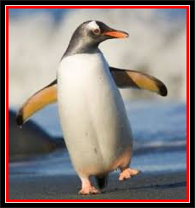
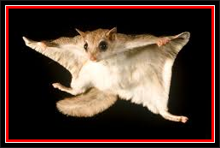
Notes – Disagreement with negative statements
I’m not tired. → I am.
I don’t want any more beer. → I do.
I don’t have enough money. → I do. / I have.
I can’t fly. → I can.

Slide 14
Additional Notes
Pronunciation
either & neither
I am too. → I’m too. I’m not either. → I am not either.
Subject: Her daughter loves jazz. → So do my neighbours.
Tense: I was hungry. → So was I.
Have: She has decided to take another session.
So have I. So did I?
So did I → have = auxiliary verb
Repeating the verb: I like dark beer. I like it too. I want to go home. → I want to, too.
never = negative I'm never late → I Neither am I.
Non-standard → me either
Negative + Positive:
I’m not married.
I’m single too.
I hate homework. I don’t like it either.
Da da da da – just for explanation

Slide 15
Let’s Practise!

